Slide 1
Insider Tips & Networking
Presented by the
NALA Ambassador & Hospitality Team

Slide 2
But First, Why?
Professional Development: Investing in your professional development is crucial for staying competitive in today's fast-paced world. Our conference offers 12.5 CLE. Full conference attendees also receive the entire 2025 Conference Recording Bundle with 42 CLE hours free of charge.
Knowledge Sharing: The conference offers a platform for sharing insights, experiences, and knowledge. Attendees can learn from industry leaders and gain valuable insights into the field's latest trends, innovations, and best practices.
Inspiration and Motivation: Attending the conference can be incredibly inspiring and motivating. Hearing success stories, learning about groundbreaking research, and being surrounded by passionate individuals can reignite your passion for your work and motivate you to tackle new challenges and pursue your goals.
Exposure to New Ideas & Perspectives: Our conference brings together people from diverse backgrounds and areas of the legal ecosystem, providing attendees with the opportunity to gain exposure to new ideas, perspectives, and approaches. This exposure can spark creativity, foster innovation, and broaden your horizons.

Slide 3
But First, Why?
Recognition and Visibility: Participating in our conference can enhance your visibility within the paralegal field. Whether you are showcasing your affiliation during our Affiliate Showcase & Reception, sharing your expertise during a Roundtable Discussion, receiving a NALA or Affiliate Award, or networking with other attendees, our conference provides a platform for you to gain recognition for your contributions and establish yourself as a thought leader in your field.
Networking Opportunities: Our conference brings together professionals, experts, and enthusiasts from various facets of the legal community, providing an unparalleled opportunity to network. Building connections with like-minded individuals can lead to collaborations, partnerships, and friendships that can last a lifetime.
Fun & Leisure: From our networking receptions to our Sip & Shop and the cultural experiences throughout Atlantic City, attendees can expect a great time while expanding their professional horizons.

Slide 4
Getting to Atlantic City
Getting to Atlantic City takes coordination, so we are here to help you plan a smooth trip!
Flying to the Conference? Here is what you need to know:
Atlantic City International Airport (ACY): Only American Airlines and Spirit offer flights to ACY.
Philadelphia International Airport (PHL): The closest major airport, with more airline options. If flying into PHL, you need transportation to Harrah’s Resort Atlantic City.
Free Shuttle from PHL to Harrah’s:
NALA Shuttle Service: Secure a free ride with NALA’s exclusive shuttle. Space is limited, so register early! The deadline to reserve your seat is June 5 (or once full). Shuttles are for conference attendees only – no guests.

Slide 5
Getting to Atlantic City
NALA Shuttle Service for Conference Attendees

Slide 6
Getting to Atlantic City
Car Rental: Prefer to drive? Rental options are available at both PHL and ACY airports. NALA members, save with your Avis and Budget affinity discounts. Parking fees apply at Harrah’s.
Self-Parking Fees: $10 after a $5 resort credit fee is applied (Sunday to Friday)
Valet Parking: $40 One-time Fee
Rideshares & Taxis: Uber, Lyft, and traditional taxis offer easy, hassle-free rides.
Train Ride from PHL: Catch the SEPTA Regional Rail to the 30th Street Station, then transfer to the NJ Transit Atlantic City Line heading to the Atlantic City Rail Terminal. Ticket prices range from $11 to $30, depending on your chosen options.

Slide 7
Getting Around Atlantic City
Atlantic City is a vibrant and walkable city with plenty of transportation options to ensure you can easily get around during your stay.
Jitney: The Atlantic City Jitney offers a convenient and budget-friendly way to get around the city. NALA will offer a dedicated jitney service for conference attendees and their guests, providing convenient transportation to the Boardwalk, Caesars, and the nearby mall. To board the shuttle, guests must have a NALA conference badge or NALA-provided jitney pass, which can be picked up at the Registration Desk. Pick up and drop off are at Harrah’s Resort Atlantic City.
Search for rides on the Jitney Surfer App
3.3 miles (approximately 10-minute drive) to the Boardwalk

Slide 8
Exploring Atlantic City
Atlantic City Beach & Boardwalk
Miniature Golf, Bally’s Beach Bar, Steel Pier
Atlantic City Aquarium
African American Heritage Museum of Southern NJ
Atlantic City Ballet
Casinos
Tourist attractions in the Atlantic City area range from Absecon Lighthouse, the tallest lighthouse in New Jersey, to Lucy the Elephant, to the iconic Atlantic City Boardwalk. Embark on a deep-sea fishing excursion, go outlet mall shopping, or discover murals and a wind farm. Find wonderful fun things to do and fascinating places to visit in Atlantic City, the entertainment capital of the Jersey Shore.

Slide 9
Fun Activities in Atlantic City
Second Saturday’s Club Beach Rave – Anchor Rock Club
Wine Down Wednesday – Anchor Rock Club
Ultimate 90s Party – Boogie Nights (Thursdays)
Galloway Green Market – Historic Smith Village (Thursdays)
Magical Mystery Doors – Ocean Casino Resort (Friday)
Darius Rucker – Hard Rock Hotel & Casino (Saturday)

Slide 10
Culinary Delights
Chart House: Near Harrah's, on the water, and has great happy hour specials. | Phil's Carousel Bar: Revolving bar
The Yard House at Bally’s: Outdoor biergarten with yard games and live entertainment | Mountain Bar: Fun Wild West bar with live music and food
Dueling Piano Bar: Gin Rickey's | Fork and Knife Restaurant: A great gem on the other side of AC but worth it
Vegan/Vegetarian
Bobby’s Burgers by Bobby Flay offers veg options
Celebrity Restaurants | Desserts
Gordon Ramsay Pub & Grill: Caesars Atlantic City | La Petite Creperie: 2831 Boardwalk
Hell’s Kitchen: Caesars Atlantic City | Alexias Patisserie: Hard Rock Hotel & Casino Atlantic City
Gordon Ramsay Steak: Harrah’s Atlantic City

Slide 11
I have decided to go… now what?
Register online & book your hotel room with the discount
Book your travel and transportation
Flying into Philly? NALA has arranged a shuttle service to transport attendees to/from Harrah's on Wednesday & Sunday. It is free, but you must register.
Check out NALA’s 2025 Commons conference community to connect with other attendees
Review the daily schedules and the Atlantic City area to set your game plan for the week
Notes:
Fly into Philadelphia Airport
Atlantic City Airport
Train SEPTA Reginal Rail 30th St. Union station transfer to NJ Transit Atlantic City
Amtrack or Greyhound

Slide 12
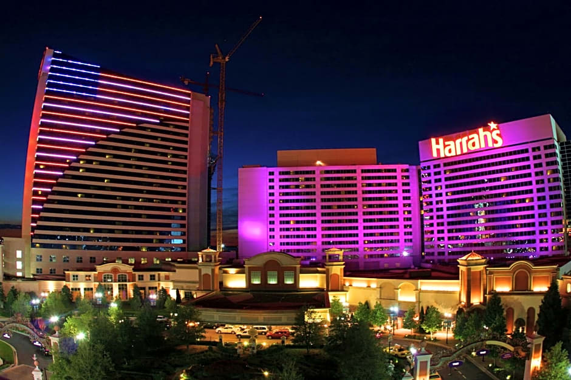
Accommodations
Hotel Address: 777 Harrah’s Blvd. Atlantic City, NJ
Room Rate: $145 per night
Amenities: Pool, Fitness Center, Full Spa

Slide 13
I have arrived at conference… now what?
After checking in at the hotel, attend the Early Registration & Happy Hour on Wednesday, July 9th, from 4:00-6:00 PM.
Pick up your Conference badge & swag and stay to jump-start your connections.
Swing by the Ambassadors & Hospitality Team table to ask questions and receive more information about conference and the Atlantic City area.
First timer? CP/ACP? Grab a ribbon and look for others to mingle with and plan dinners, outings, and meetups.
HAVE FUN!

Slide 14
Contact Us
2025 NALA Ambassador & Hospitality Team
Cate Benge (Staff) Adrienne Berry, ACP
Vinnie Finley (Staff) Kerry Mackey, CP
Christine Principe, CP Laurie Robinson
Candace Russell Nita Serrano, ACP
Callie Spencer (Staff) Deana Waters, ACP
Mariah Williams (Staff)
Be sure to join the 2025 NALA Conference & Expo community on Commons to stay up to date with the latest from NALA and the A&H Team.
nala.org
nalanet@nala.org
918-587-6828 Ext. 403

