Slide 1


Slide 2


Slide 3


BROWARD COLLEGE
Start Your Journey at Broward College

Slide 4

About NALA
Our Mission
Equipping paralegals for the challenges of the future through certification, professional development, and advocacy.
Our Vision
Ensuring paralegals are known and valued as an integral part of the legal ecosystem.
Over 21K paralegals have been NALA certified since 1977!

Slide 5
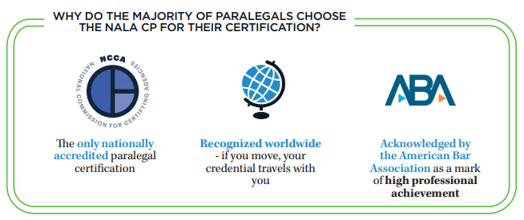
NALA CP® CERTIFICATION

Slide 6
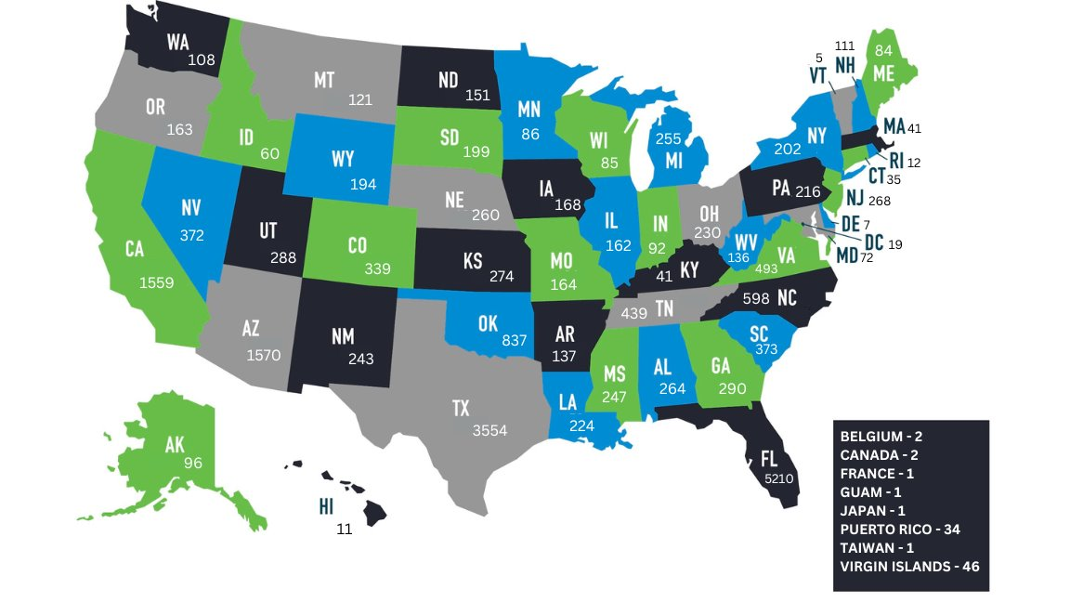
CERTIFIED PARALEGALS BY AREA
Last updated 1/1/2025
Notes:
Here is a quick glance of the CPs across the globe. The handouts that we provide you with at the end will have a link with updated numbers as they are updated every time a group of examinees pass the Skills Exam.

Slide 7

NATIONALLY ACCREDITED
Standards
Validation
Third-party
Impartial

Slide 8
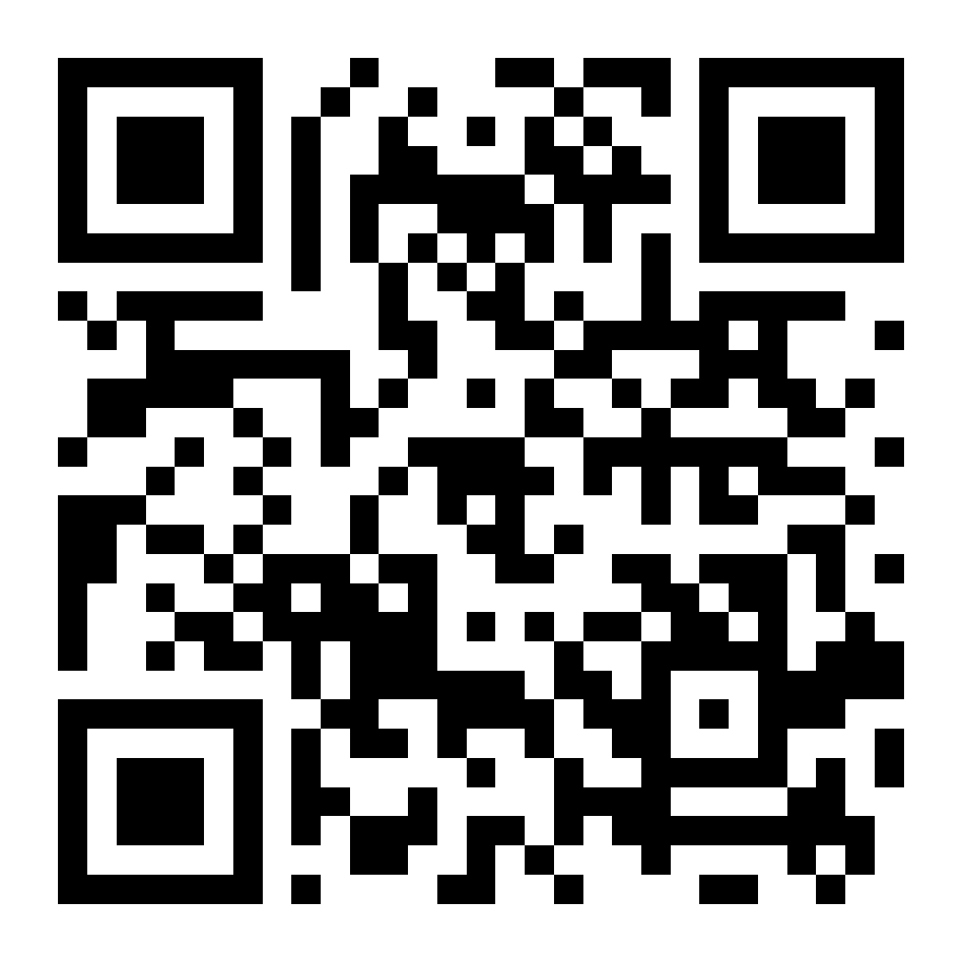
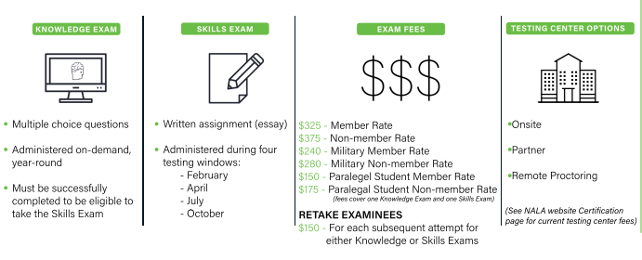

CERTIFIED PARALEGAL EXAM

Slide 9
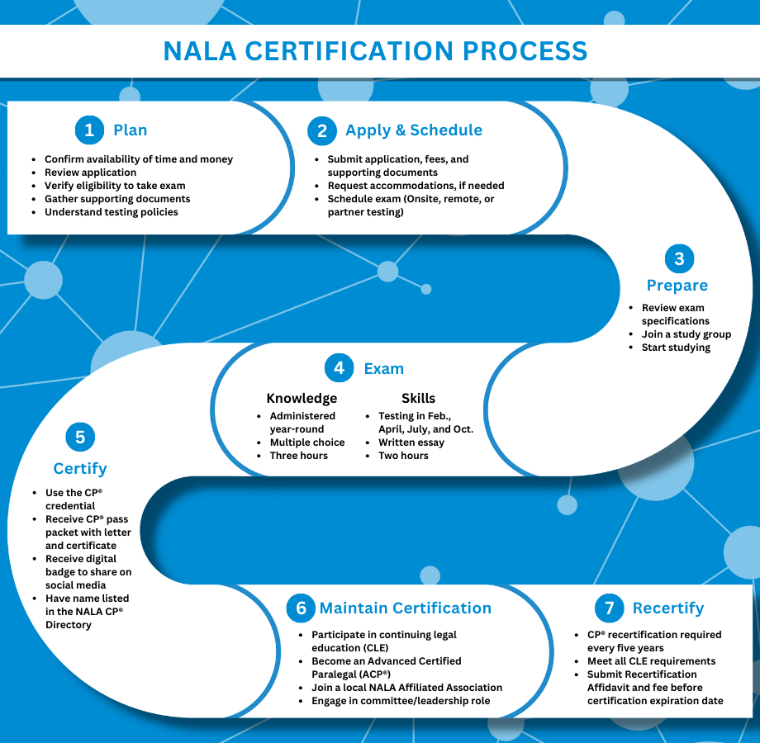
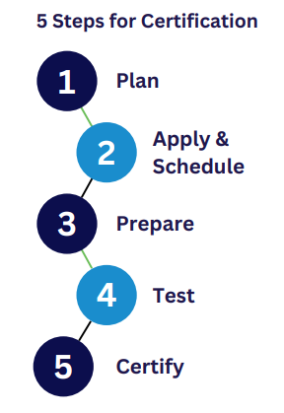

Slide 10
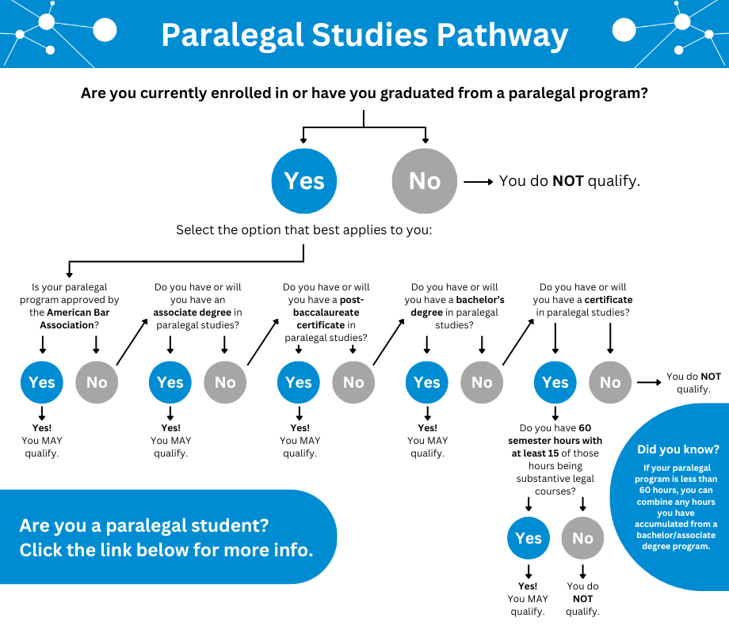
ABA approved
Associates degree
Post-baccalaureate certificate
Bachelor’s degree
Certificate program

Slide 11

Supporting Documentation
(Paralegal Studies Pathway)
Student Applicant:
Military Applicant:
Official transcript(s); or
Proof of military status
Official transcript(s); or
Standard Applicant:
Official transcript(s); or
Letter of completion
Letter of completion
Letter of completion
*Note: An official letter of completion or a copy of your diploma may also be submitted for review if the transcript is not attainable. However, we must be able to determine your eligibility.

Slide 12
TESTING CENTER MODALITIES
Onsite Testing
Partner Testing
(employer, military base, or school)
Remote Proctoring
Knowledge Exam $50
Knowledge Exam $67
Skills Exam $60
Knowledge Exam $20
Skills Exam $20

Slide 13
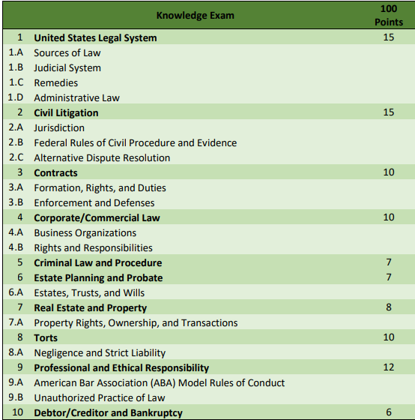
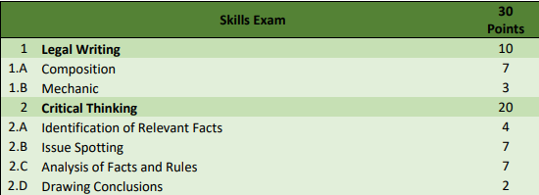
EXAM SPECIFICATIONS

Slide 14
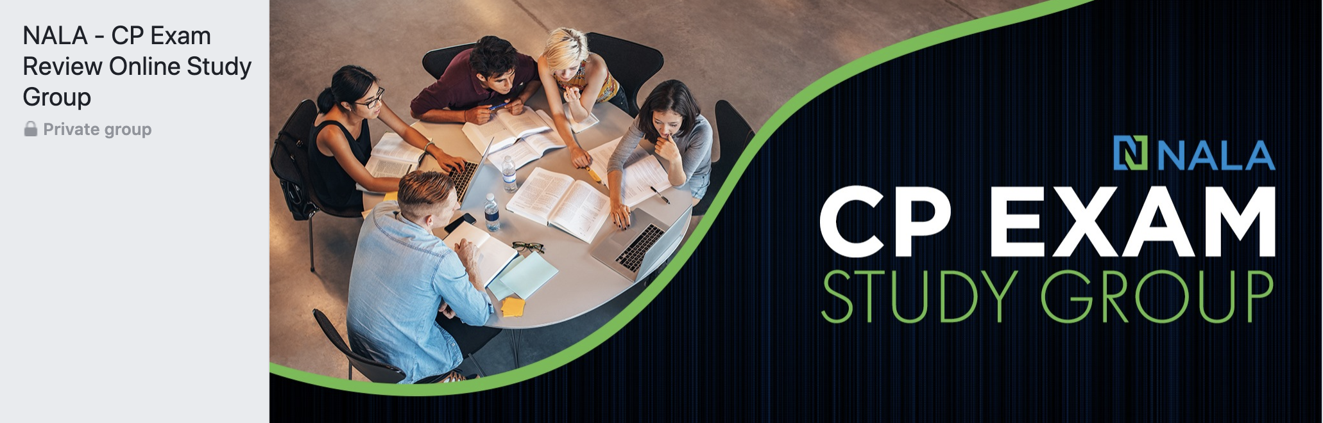
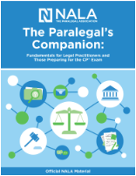
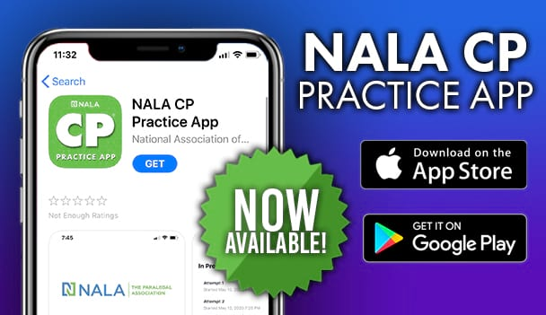
ONLINE STUDY OPTIONS
We offer a variety of study materials to help examinees study for the CP Exams.
STUDY OPTIONS:
NALA – CP® Exam Review Online Study Group on Facebook
The Paralegal’s Companion book published by NALA
Online CP® Practice Exam & App
CP® Review Course Bundle
DISCLAIMER: The NALA CP® Exam creators do not develop or deliver any CP® Exam study materials. Producers of study materials do not have access to actual CP® Exam content. Use of any suggested study materials does not guarantee success on the CP® Exam.

Slide 15
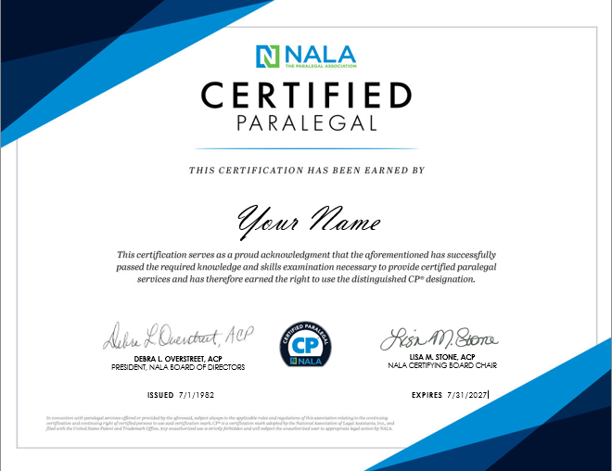
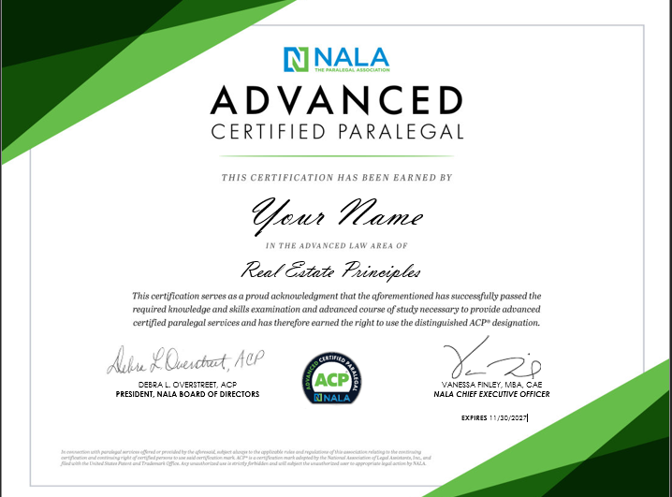
CP/ACP CERTIFICATE
Notes:
Envision YOUR NAME on one or both of these certificates! They are highly recognizable and shows that you have earned the right to be called a NALA CERTIFIED PARALEGAL OR ADVANCED CERTIFIED PARALEGAL!

Slide 16
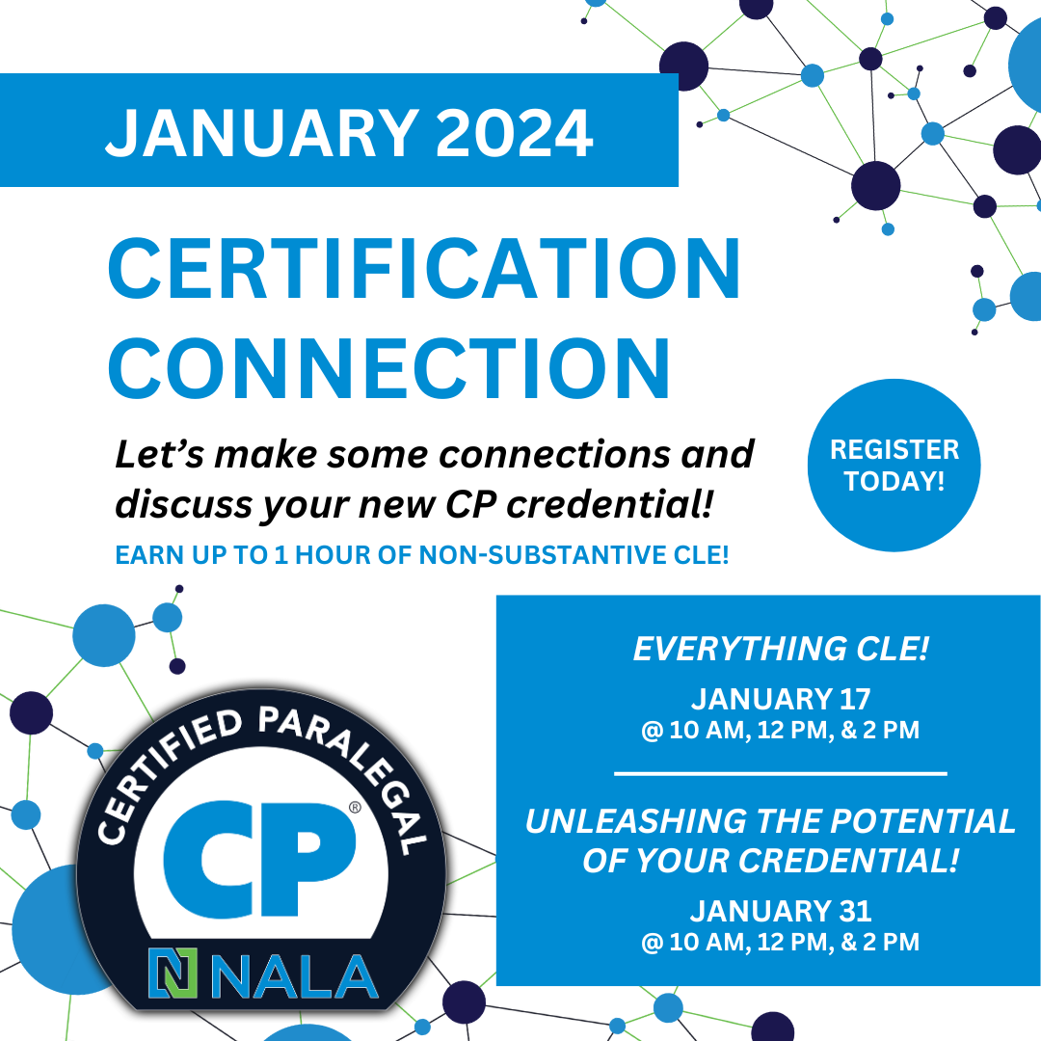

CERTIFICATION CONNECTION

Slide 17
BENEFITS OF MAINTAINING CERTIFICATION
Professional Development
Increased Salary
Digital
Badge
Worldwide Recognition
Diversity, Equity, & Inclusion

Slide 18
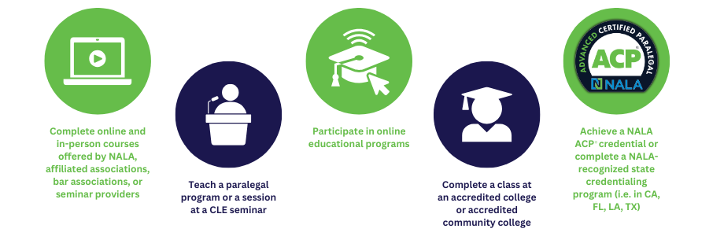
CLE OPPORTUNITIES

Slide 19

DIVERSITY, EQUITY, AND INCLUSION
NALA advocates for and encourages diversity, equity, and inclusion within the paralegal profession. We recognize that to continually “ensure paralegals are known and valued as an integral part of the legal ecosystem,” we must build on and derive strength from inclusion, equity, diversity, and those initiatives that promote it. NALA encourages and fosters a diverse, equitable, and inclusive environment within the association and its Affiliated Associations, as well as the law firms, corporations, legal service providers, and paralegal community our members and peers support. NALA strives to partner with Affiliated Associations and other professional legal organizations to advance and promote diversity, equity, and inclusion.

Slide 20
MEMBERSHIP TYPES
$154
$129
$50
  ACTIVE
  This is our most common membership type. It is the only membership that includes full voting privileges and all the benefits. Active Type Members also have the opportunity to serve on the NALA Board of Directors and other committees.
  *Contact NALA to learn more about discounts for Organizations and members of affiliated associations.
  ASSOCIATE/
  SUSTAINING
  Associate/Sustaining Members receive member benefits excluding those only for Active Type Members.
  This membership is ideal for those who are not paralegals but endorse and promote the paralegal profession.
  STUDENT
  Student Members receive member benefits excluding those for only Active Type Members.
  This membership is geared towards students who are in good standing and are pursuing a course of study as a paralegal.
PER YEAR
PER YEAR
PER YEAR

Slide 21

$5 Student Membership

Slide 22


NALA's award-winning quarterly journal, Facts & Findings, is a premier source of information designed specifically for paralegals. This magazine offers the best in educational articles written by paralegals, attorneys, and other experts. In addition to feature articles, each issue includes columns on ethics and technology.
NALA members receive a complimentary yearly subscription to these journals. Members can access all issues anytime directly from their personal NALA account. Non-members can subscribe for $35 per year.
MEMBERS CAN ALSO EARN FREE CLE FOR READING SELECT ARTICLES!

Slide 23
NALA RESOURCES FOR
THE PARALEGAL PROFESSION
Membership
Career Center
Paralegal Resource Navigator​
Utilization and Compensation Survey
Certification
Planning for NALA Certification
Exam Specifications
CP® Exam FAQs
CP® Recertification FAQs
NALA Commons

Slide 24
FOR MORE INFORMATION
call us at
918-587-6828
visit our website at
www.nala.org
Write us at
testing@nala.org

Slide 25






THANK YOU

